Slide 1
Using LFADS for analysis of reaching and grasping activity data
Maksym Patiiuk, Adam G. Rouse, 2020

Slide 2
Introduction
In 2016 Dr. Rouse published a paper that quantified the extent to which variation in firing rates depended on location, on object, and on their interaction—all as a function of time.
The data used in that paper represents activity of neurons as monkeys performed reaching, grasping, and manipulation of four different objects in up to eight different locations.
Today we are going to compare the results of that study with what LFADS produced after being run on the same dataset.
About the task:
Each monkey performed a behavioral task that dissociated the location to which the monkey reached from the object the monkey grasped and manipulated. Four objects—a coaxial cylinder, a perpendicular cylinder, a button, and a sphere—were arranged at 45° intervals on a circle. Each of these peripheral objects was positioned at a 13 cm radius from a fifth, center object, another coaxial cylinder. Between blocks of trials, the entire apparatus was rotated about the center object such that different peripheral objects were located at up to eight locations, spanning a range from 0° (to the monkey’s right on the horizontal meridian) to 157.5° (to the left, 22.5° above the horizontal meridian) in steps of 22.5°.
Rouse, Adam G., and Marc H. Schieber. "Spatiotemporal distribution of location and object effects in primary motor cortex neurons during reach-to-grasp." Journal of Neuroscience 36.41 (2016): 10640-10653.

Slide 3
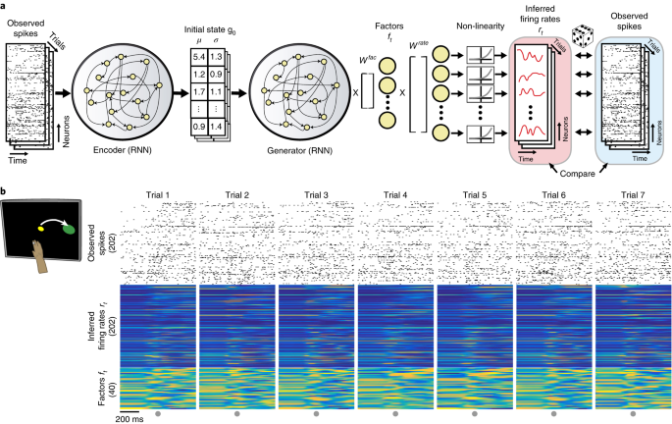
About LFADS
Neuroscience is experiencing a revolution in which simultaneous recording of thousands of neurons is revealing population dynamics that are not apparent from single-neuron responses. This structure is typically extracted from data averaged across many trials, but deeper understanding requires studying phenomena detected in single trials, which is challenging due to incomplete sampling of the neural population, trial-to-trial variability, and fluctuations in action potential timing.
Latent factor analysis via dynamical systems (LFADS) is a deep learning method to infer hidden dynamics from single-trial neural spiking data. When applied to motor cortical datasets, LFADS predicts observed behavioral variables, extracts precise firing rate estimates of neural dynamics on single trials and combines data from non-overlapping recording sessions spanning months to improve inference of underlying dynamics.
Inferring Single-Trial Neural Population Dynamics Using Sequential Auto-Encoders (1:36:07)
Example of the underlying RNN used by LFADS
Pandarinath, Chethan, et al. "Inferring single-trial neural population dynamics using sequential auto-encoders." Nature methods 15.10 (2018): 805-815.

Slide 4
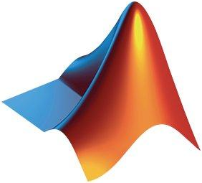
About LFADS Run Manager
LFADS Run Manager is a set of tools, written in Matlab with some accompanying Python code, that helps organize, train, and analyze LFADS models.
It accompanies the actual Python and Tensorflow LFADS code.
Run Manager is used to organize LFADS runs and to facilitate generation of the appropriate scripts to train models and loading of the resulting model predictions for further analysis.
MATLAB® Logotype
Pandarinath, Chethan, and Dan O’Shea. “LFADS Run Manager for Matlab Documentation.” GItHub Pages, Stanford University, 2017, lfads.github.io/lfads-run-manager.

Slide 5

Making Run Manager cross-platform
LFADS Run Manager and LFADS python scripts were intended to be run on the same machine.
We decided to use cloud computing to make every step of running LFADS cross-platform. Meaning you can prepare your dataset on one machine, run analysis on a remote server and plot results on a yet different computer.
We used Google Colaboratory to accomplish part of this goal. It is a hosted Jupyter notebook service that requires no setup to use, while providing free and paid access to computing resources, GPUs and compatible TensorFlow libraries.
Google Colaboratory® Logotype
Google Research. “Computation Through Dynamics.” GitHub, Google, 2018, github.com/google-research/computation-thru-dynamic

Slide 6
Running LFADS and extracting results
Transform .mat dataset into a format supported by LFADS Run Manager.
Run LFADS Run Manager to generate initial weights for the RNN.
Upload resulting dataset to Google Drive and mount it in a Shared Colab Runtime.
Run all steps of a Jupiter Notebook.
Download modified dataset from Google Drive.
Run MATLAB scripts that plot final results.
Throughout each of these steps there are customization options available for greater versatility.

Slide 7
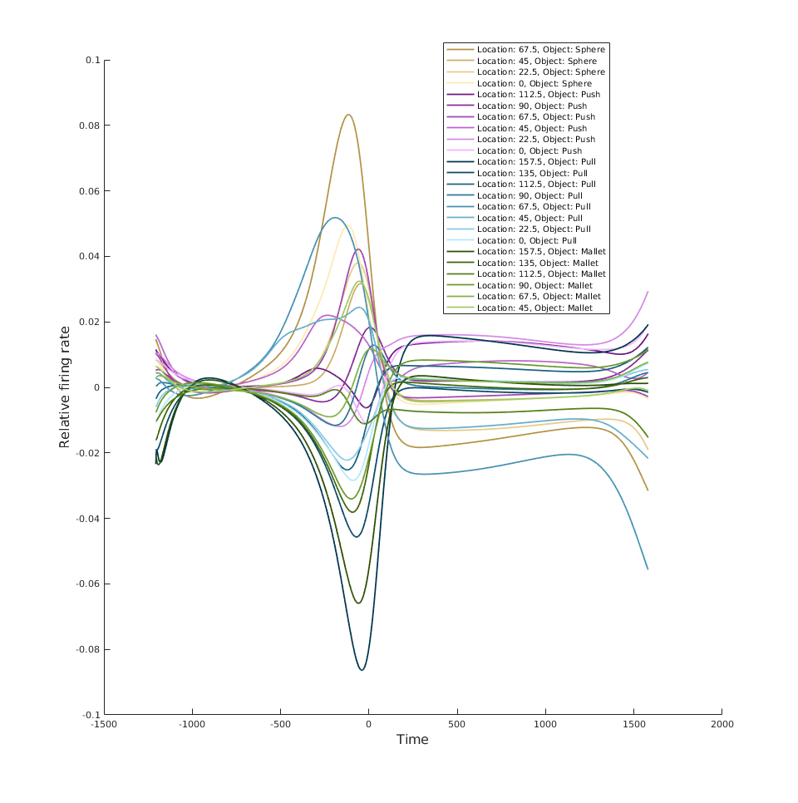
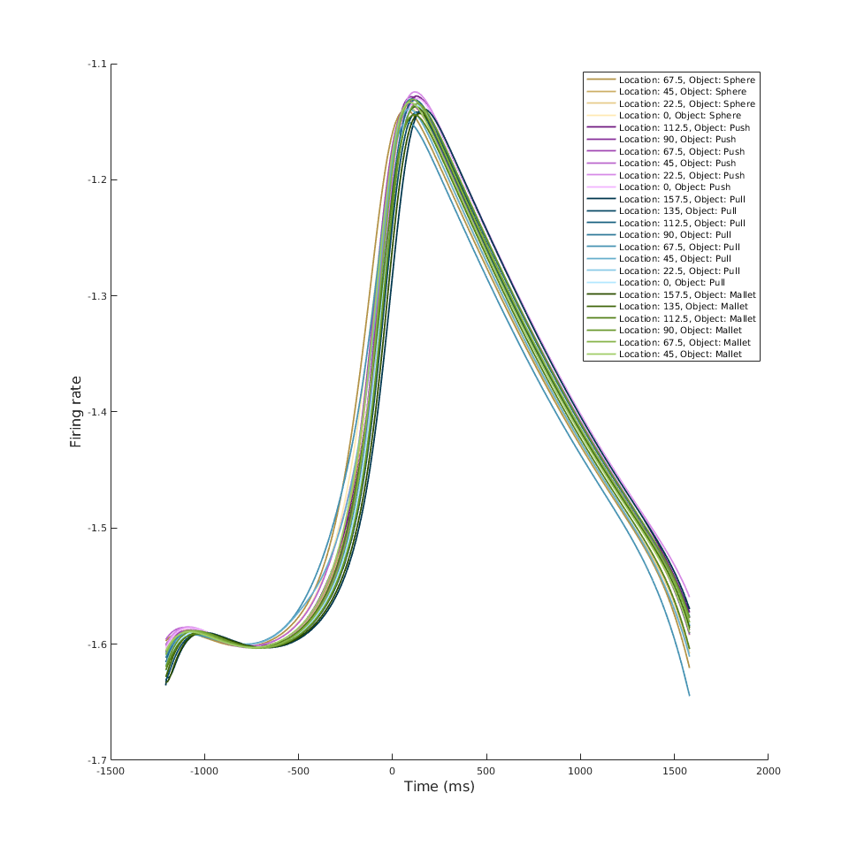
Factor 1

Slide 8
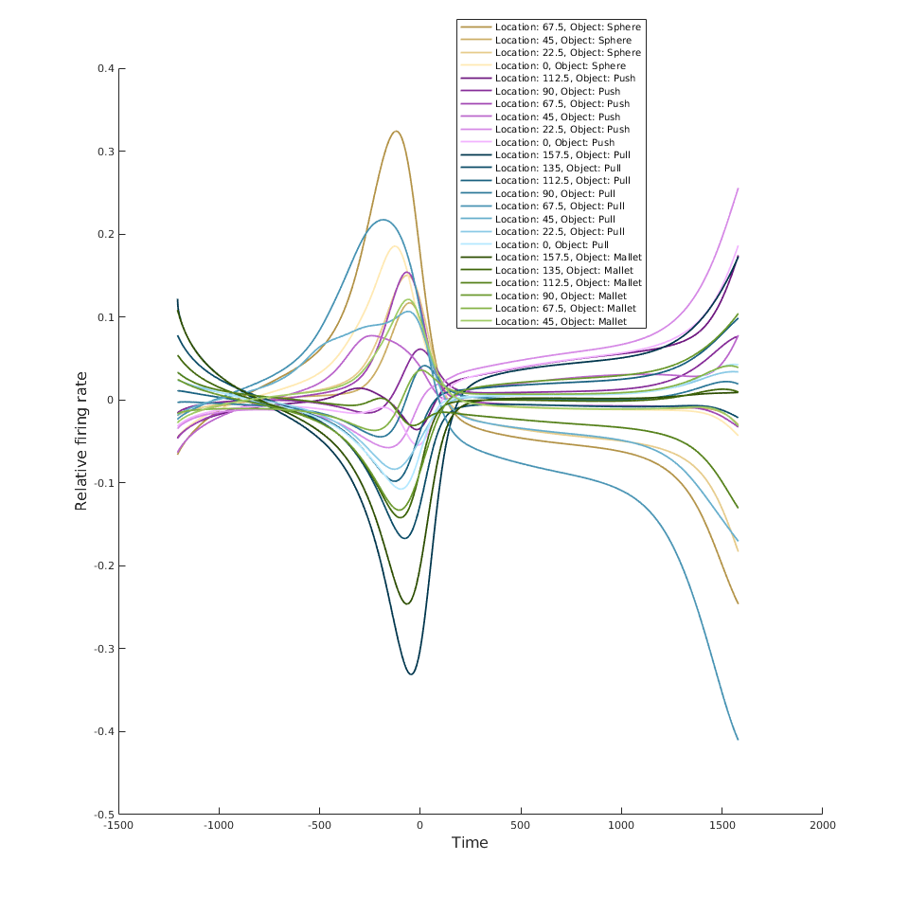
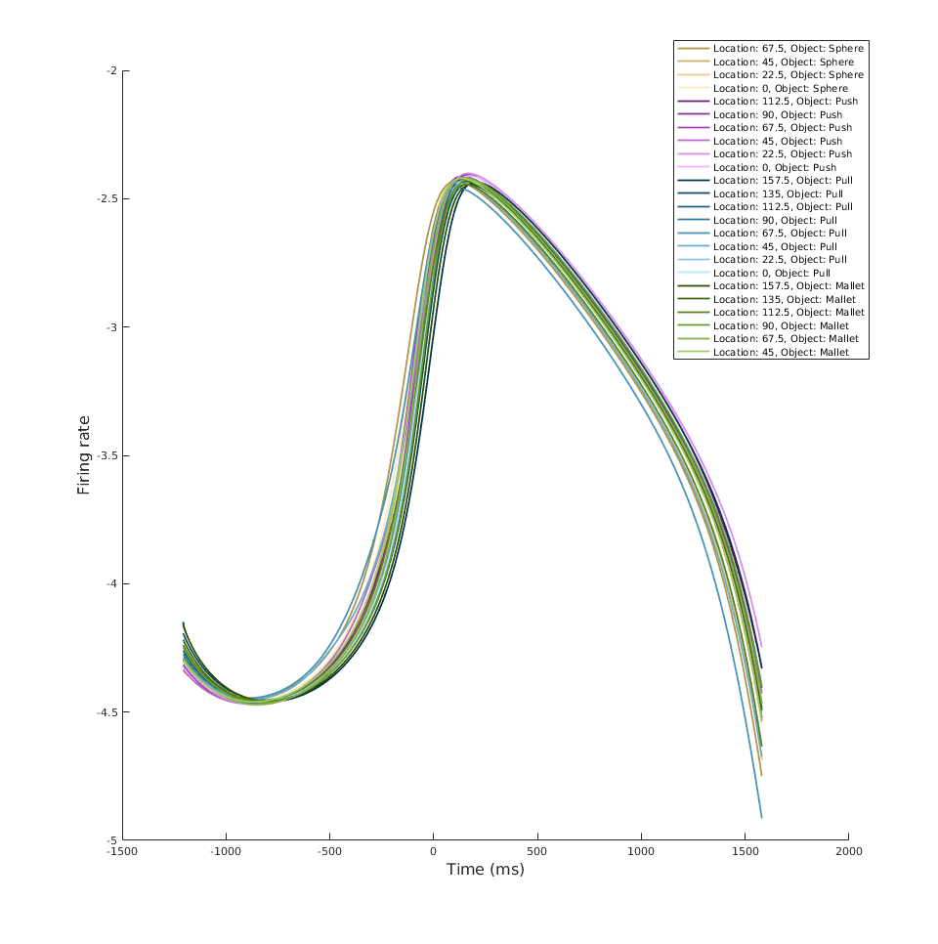
Factor 2

Slide 9
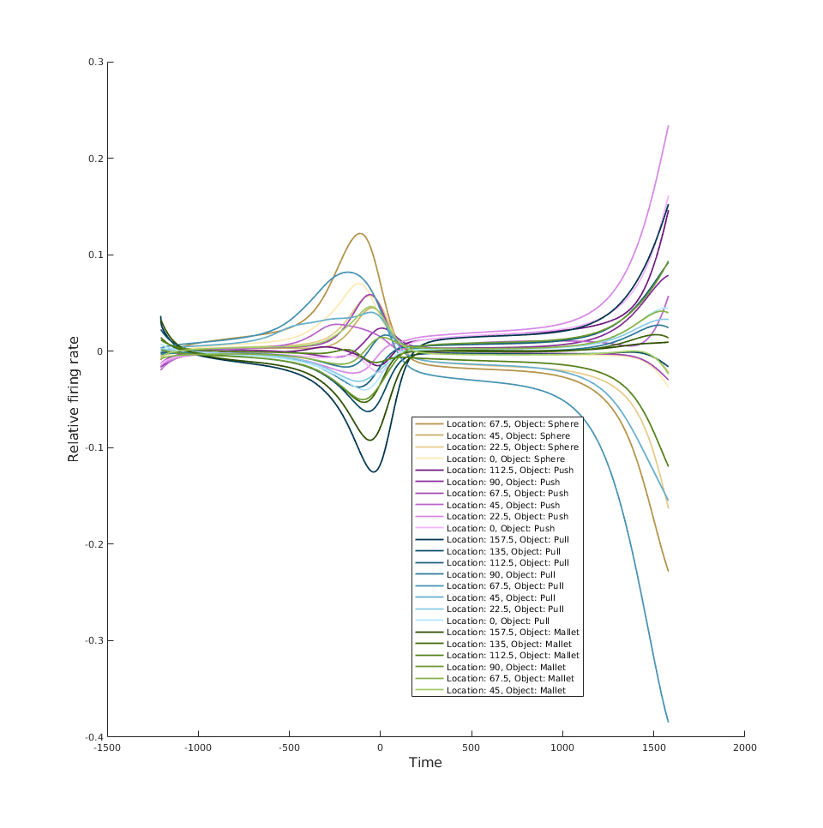
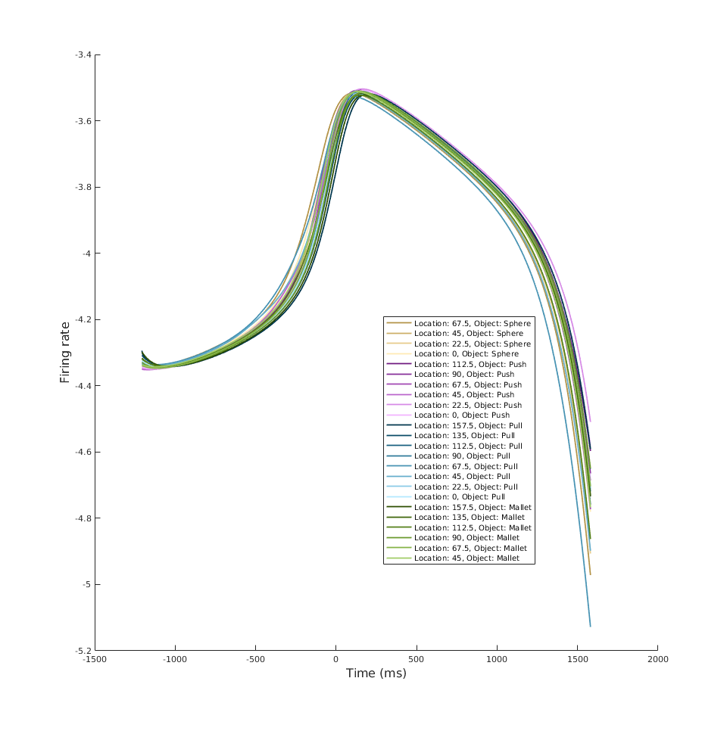
Factor 6
https://github.com/Precision-Neural-Dynamics-Lab-KUMC/LFADS

Slide 10
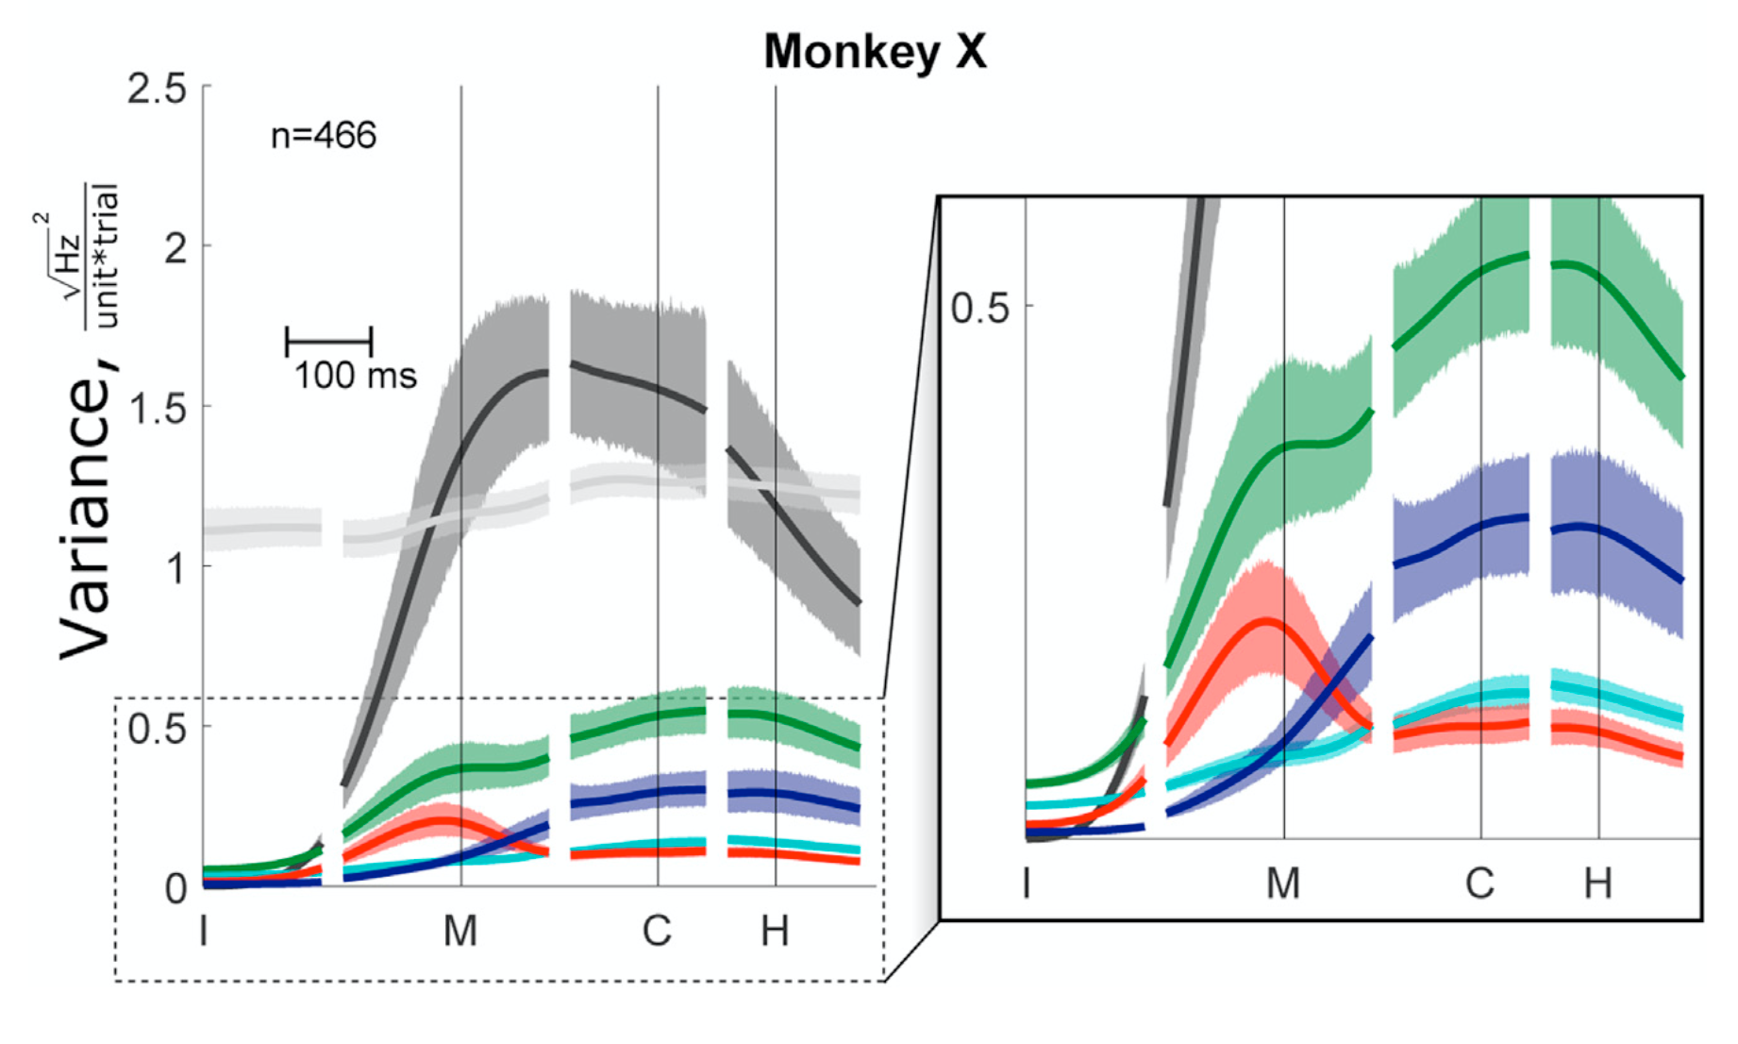
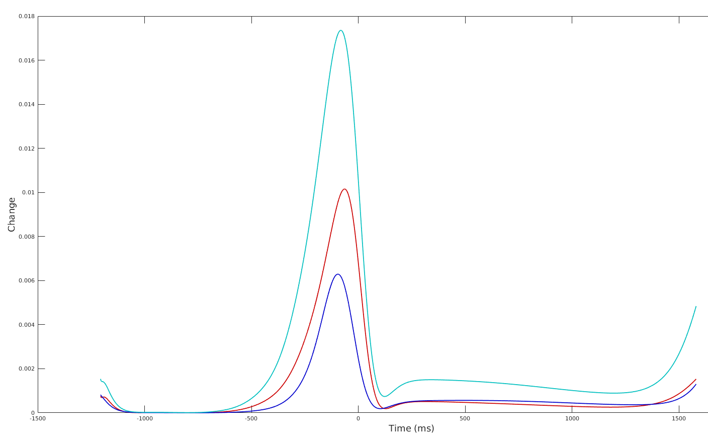

The Condition-independent changes in factors are very large compared to the specific location-object effects.
The timing for when there is the most variance for location and object are very similar, not location first and object second like in the papers published by Dr. Rouse
Rouse, Adam G., and Marc H. Schieber. "Condition-dependent neural dimensions progressively shift during reach to grasp." Cell reports 25.11 (2018): 3158-3168.

Slide 11
Possible Improvements
There is a new version of MATLAB Run Manager in the development - AutoLFADS. It is designed to be compatible with Google Cloud. We are currently looking into implementing it.
We might have to experiment with learning rate because the network is slow to pick up changes to brain activity and relies on old data too much.
Initial weights can be hit or miss, meaning the time it takes to run LFADS can fluctuate from run to run as initial learning conditions are generated closer or farther from the expected result.
Python implementation of LFADS is running on a deprecated version of Python - 2.7. It reached end of life on January 1st, 2020. Transitioning to AutoLFADS would fix this issue as it is built on Python 3
No Windows support is available for anything but plotting data. Transitioning to AutoLFADS will fix this issue as it more cloud-friendly.

Slide 12
List of Citations and Resources Used
Rouse, Adam G., and Marc H. Schieber. "Spatiotemporal distribution of location and object effects in primary motor cortex neurons during reach-to-grasp." Journal of Neuroscience 36.41 (2016): 10640-10653.
Pandarinath, Chethan, et al. "Inferring single-trial neural population dynamics using sequential auto-encoders." Nature methods 15.10 (2018): 805-815.
Simons Institute, and David Sussillo. “Inferring Single-Trial Neural Population Dynamics Using Sequential Auto-Encoders.” YouTube, uploaded by Simons Institute, 22 Mar. 2018, www.youtube.com/watch?v=08xa7bE5iTQ&t=357s.
Google Research. “Computation Through Dynamics.” GitHub, Google, 2018, github.com/google-research/computation-thru-dynamics.
Yamanishi, K. “Latent Dynamics – In Pursuit of Simplicity in Complexity.” Latent Dynamics, University of Toronto, 2015, latent-dynamics.net.
Pandarinath, Chethan, and Dan O’Shea. “LFADS Run Manager for Matlab Documentation.” GItHub Pages, Stanford University, 2017, lfads.github.io/lfads-run-manager.
Rouse, Adam. “Precision Neural Dynamics Lab.” KUMC, KUMC, www.kumc.edu/school-of-medicine/neurosurgery/research/precision-neural-dynamics-lab.html. Accessed 17 Sept. 2020.
Rouse, Adam. “Adam G. Rouse.” Google Scholar, KUMC, scholar.google.com/citations?user=6GD9SU4AAAAJ. Accessed 17 Sept. 2020.
Rouse, Adam G., and Marc H. Schieber. "Condition-dependent neural dimensions progressively shift during reach to grasp." Cell reports 25.11 (2018): 3158-3168.

Slide 13
Q&A

